Slide 1
Integrum information service
User’s manual in Power Point
April 2010

Slide 2
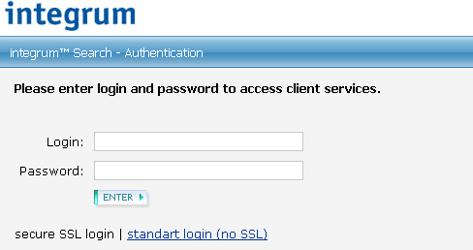
Password-based access
Go to http://aclient.integrum.ru/login.aspx?si=2E and enter your login and password

Slide 3
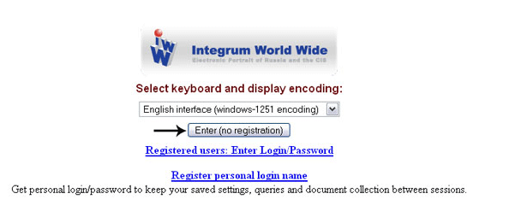
IP-based access
Follow the assigned link and choose the encoding. Press Enter (no registration)

Slide 4
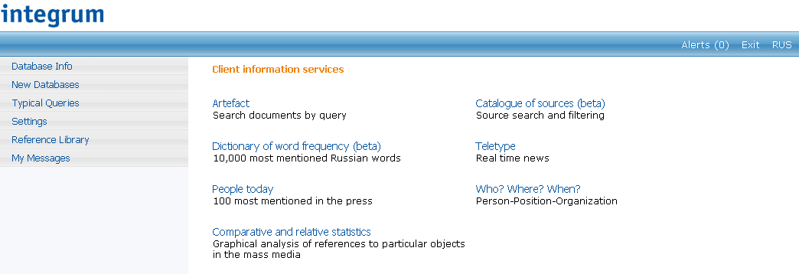
Choose the service you want to use:
Database search – main service of Integrum or
Special research services

Slide 5
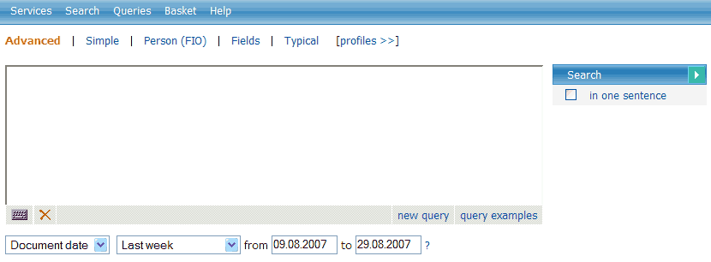
Click on Artefact
and Integrum’s main search service starts :

Slide 6
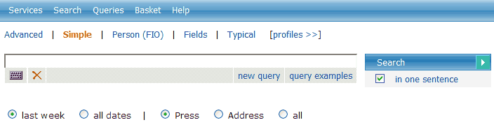
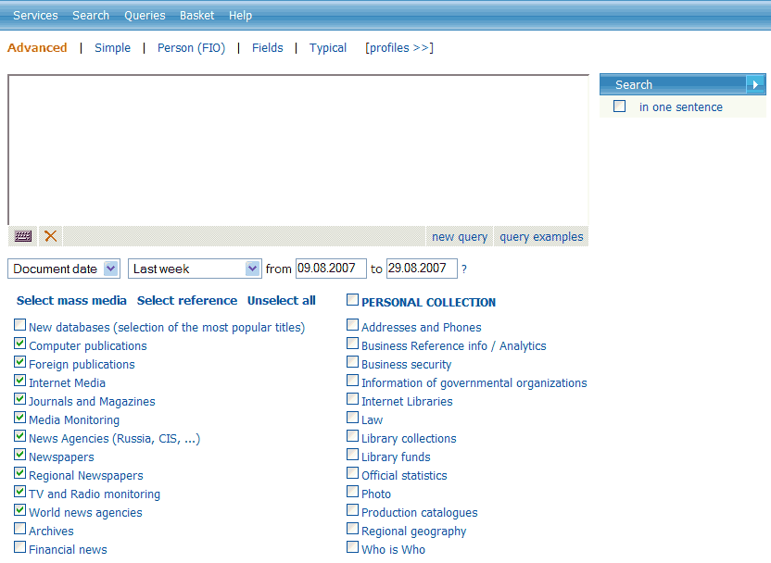
Choose simple or advanced interface

Slide 7
Read and print query examples for a quick start

Slide 8
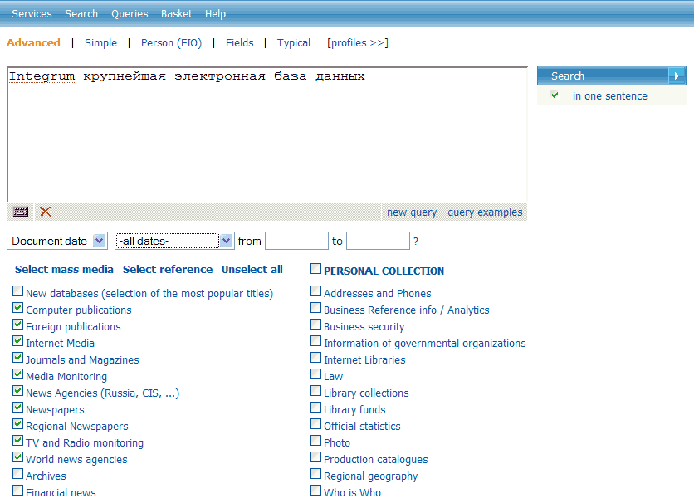
If necessary define the proximity level
Click
Search button
Enter your search
query
Choose the dates
Choose the databases
Or define your personal
set of databases

Slide 9
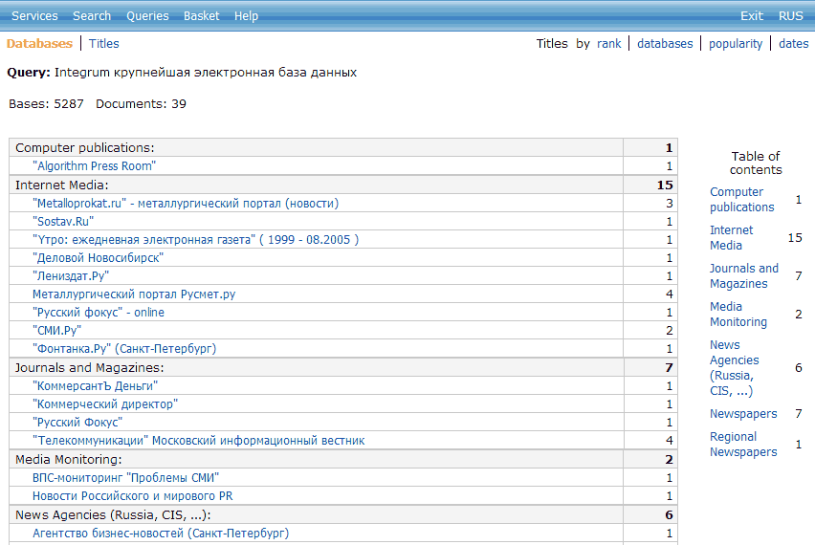
Get search results
Choose the View
Sort the results

Slide 10
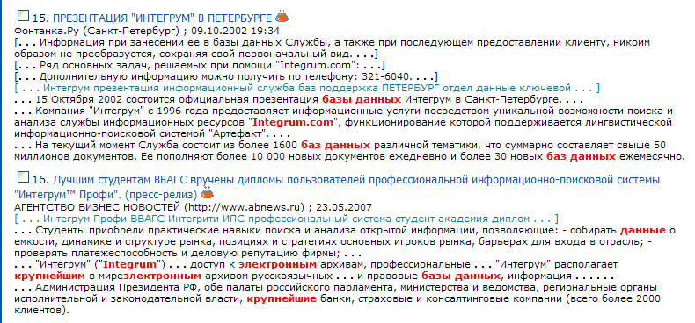
Open the search results
The name of the
database and time
Relevant fragment
of the document
Click the title
of the document
to open the full text
Key sentences and
key words of the
document
Search engine finds documents with all grammatical forms of the words
in the search query. If you need documents with the exact form of the word,
use operator !т after the word in search query, e.g.
крупнейшей!т

Slide 11
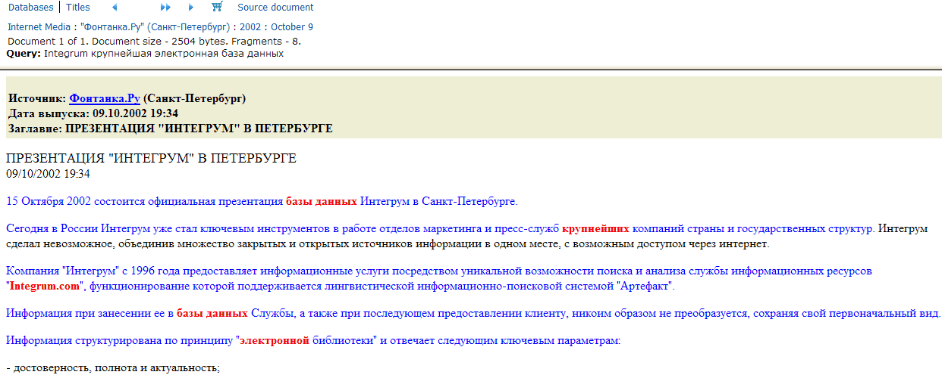
Open full text of the found document
Click to go
to the next
document
If necessary
store the found documents
in the individual basket
Process and send them
by e-mail
Click to jump to the part
of the document
containing the words
of the search query
Click to go
to the source document

Slide 12
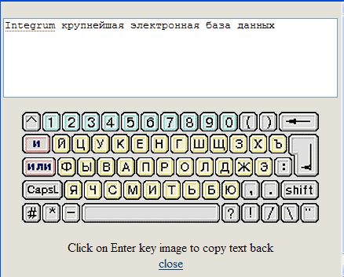
Problems with Cyrillic keyboard?
Use virtual keyboard

Slide 13
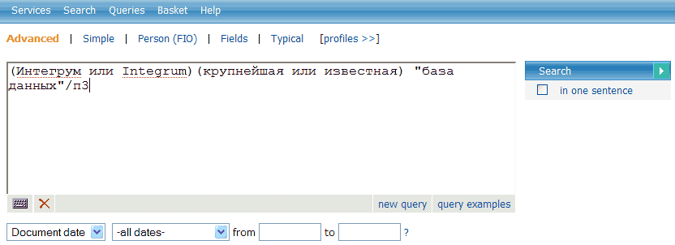
Use various options of Artefact, Integrum’s proprietory search engine
Operator AND can be omitted
Use quotation marks to define groups
of words
Define proximity level
Use operator /пN (or /sN) to find documents
containing words of search query
in N consecutive sentences
In this example –
n 3 consecutive sentences
Read details of query language

Slide 14

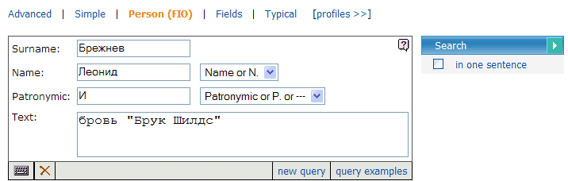
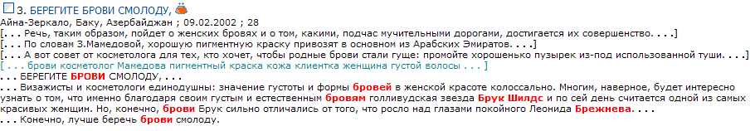
Integrum’s professional search
Find documents relevant to a person
Click to find documents
relevant to a person
Enter Family name
Enter First name or Initial
If you know Patronymic enter it
in full or an Initial
Enter context

Slide 15
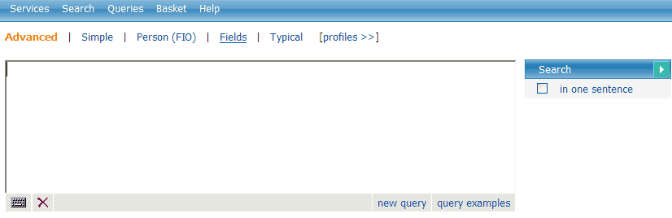
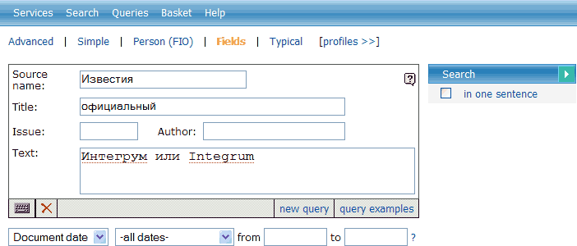
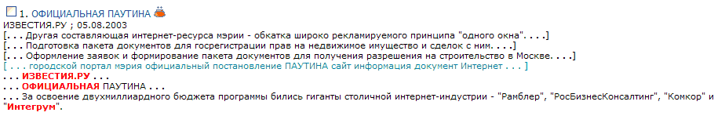
Integrum’s professional search
Find documents relevant to its fields
Click to find documents
relevant to the field
Enter full name of database or its part
Enter the words to be seen in the title
Enter the number of the issue if you know it
Enter the words to be seen in the document
If required enter the dates

Slide 16
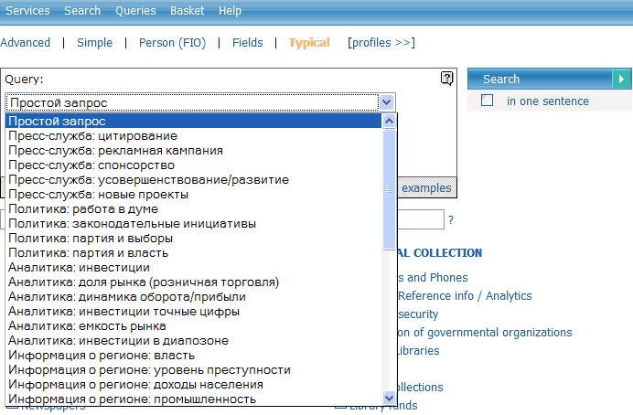
Integrum’s professional search
Integrum builds up a search query for the most popular topics
Click to start the service of Typical queries
Choose your topic from pop-down menu

Slide 17
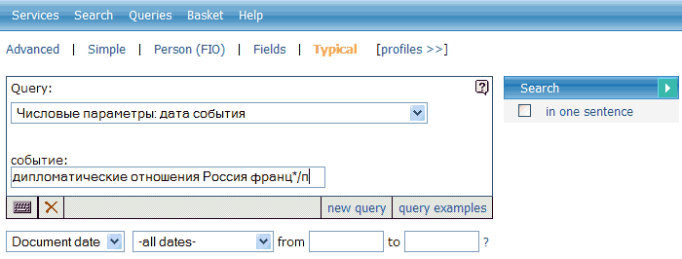
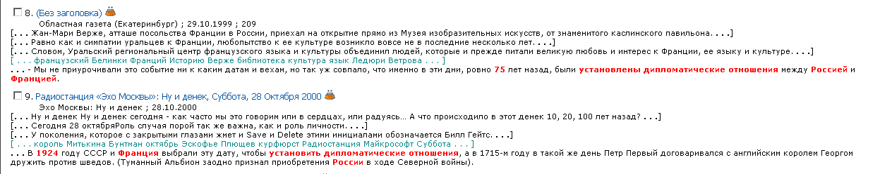
Example of professional search
Automatic search of the date of any event
Describe the event which date
you are looking for
Get the result

Slide 18
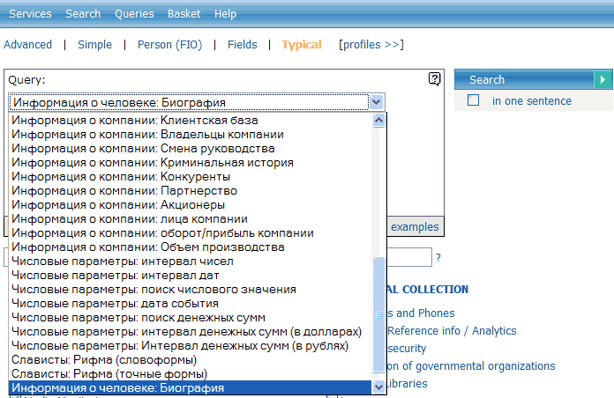
Example of professional search
Search for biographical data of a person in mass media
Choose your topic from pop-down menu

Slide 19
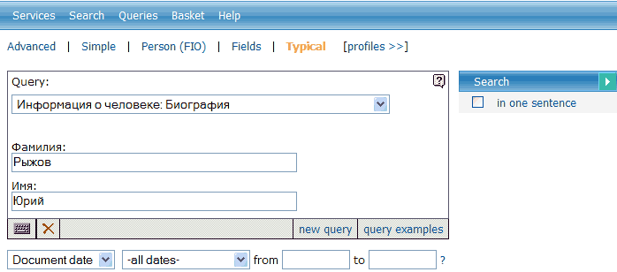
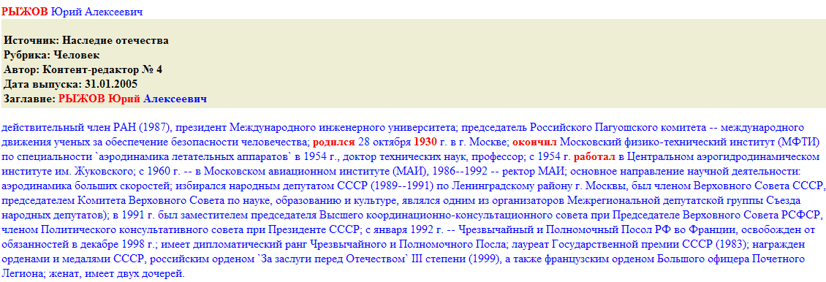
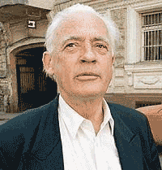
A biography of the former Russian Ambassador to France
Enter the name of the person whose
biography you are trying to find
Get the result

Slide 20
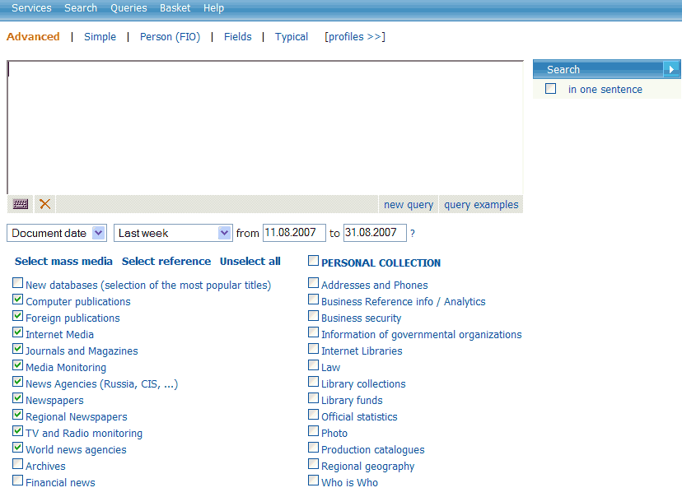
Check more details about archives of Integrum databases
Click on the Name
of the database group

Slide 21
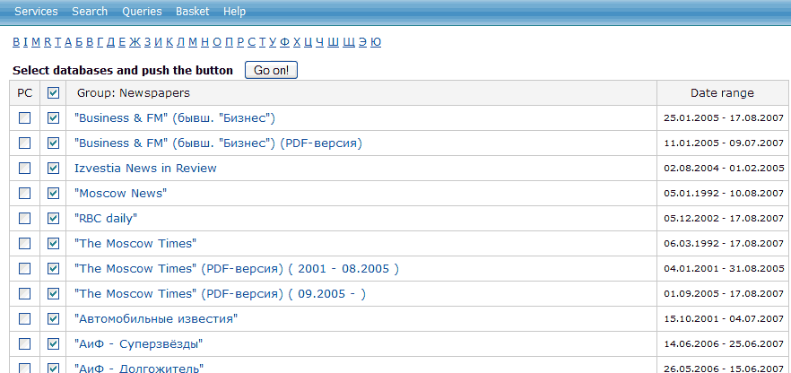
Use alphabet for quicker navigation
within list of databases and
click on the database of your choice

Slide 22
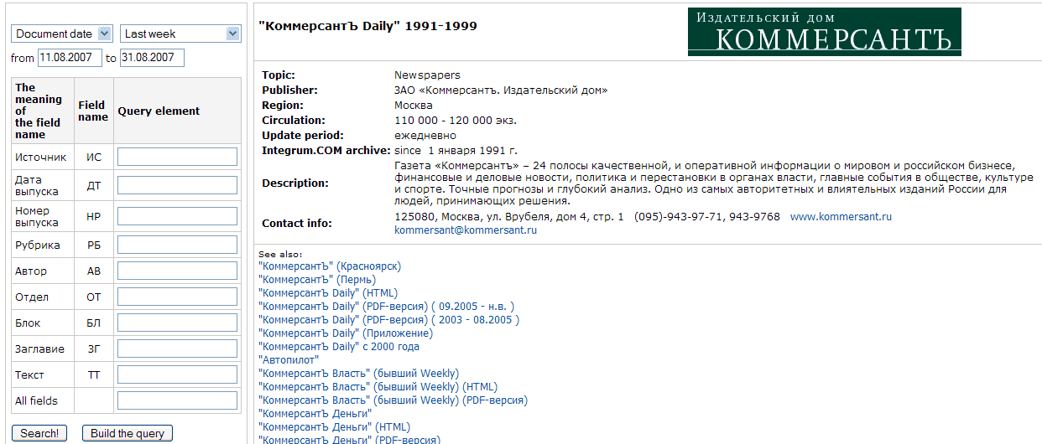
Notice that for quicker search
some large archives are divided into several databases.
Here, for the issues after 1999 check
the next database
If required search the database
by field of document
Check details
of the newspaper

Slide 23
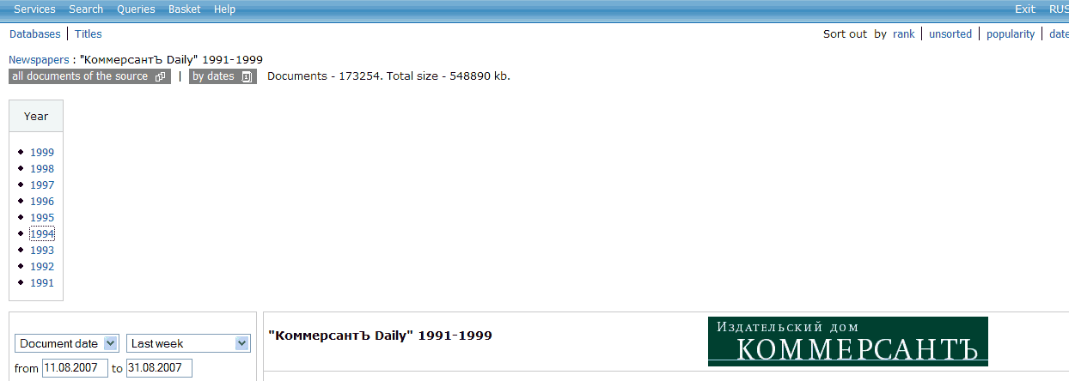
Do you want not to search but just to read a newspaper?
Use Integrum as an electronic library.
Choose the year and go
to the calender grid
Check all documents
of the database

Slide 24
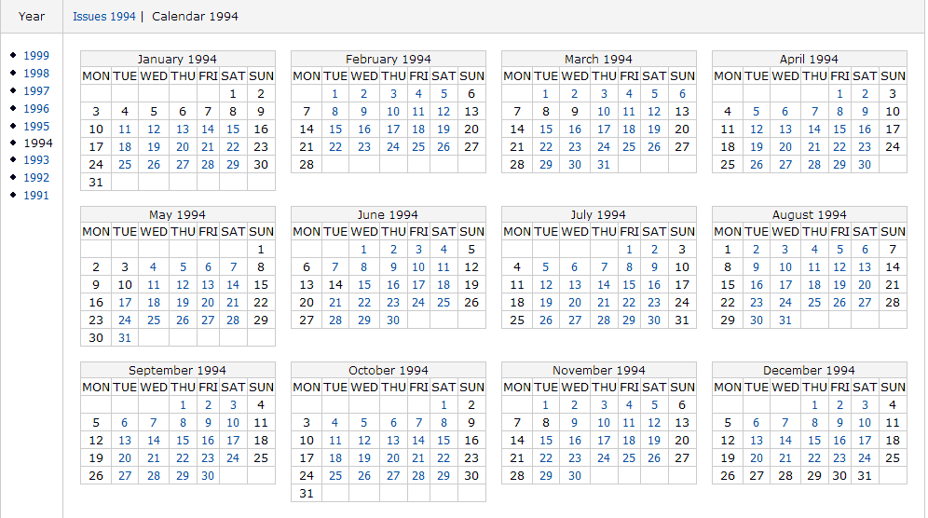
Choose the date and start reading the issue

Slide 25
Check Integrum’s reference information
Click here

Slide 26
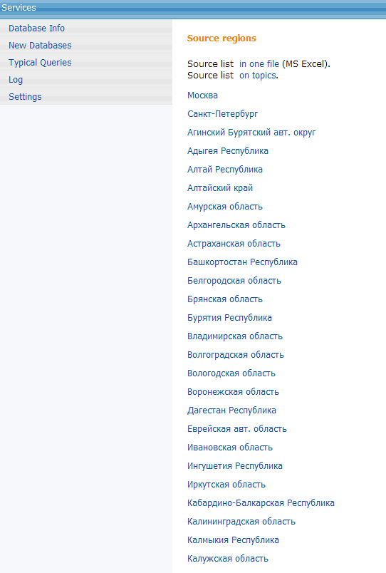
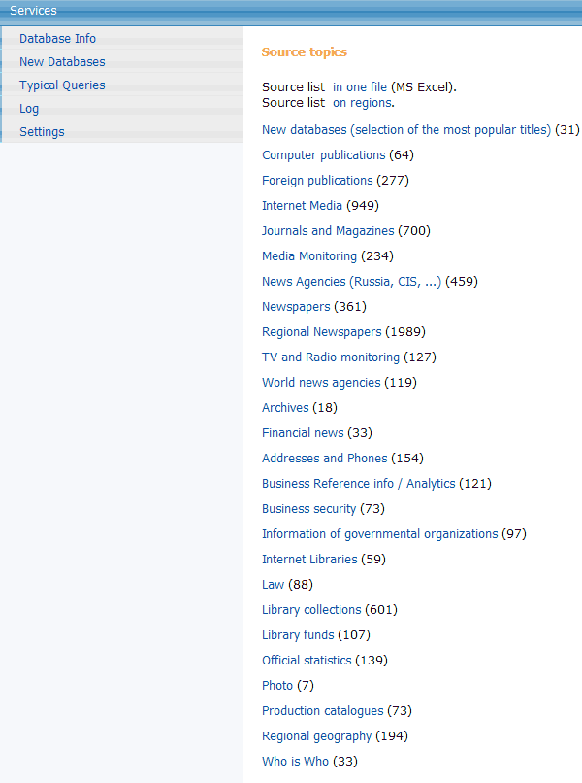
Get the list of databases relevant to any geographical region or group of databases
Click here to get list of databases
by regions
Click here to get the statistics
by groups of databases

Slide 27
Special services for researchers
Click here
Click here

Slide 28
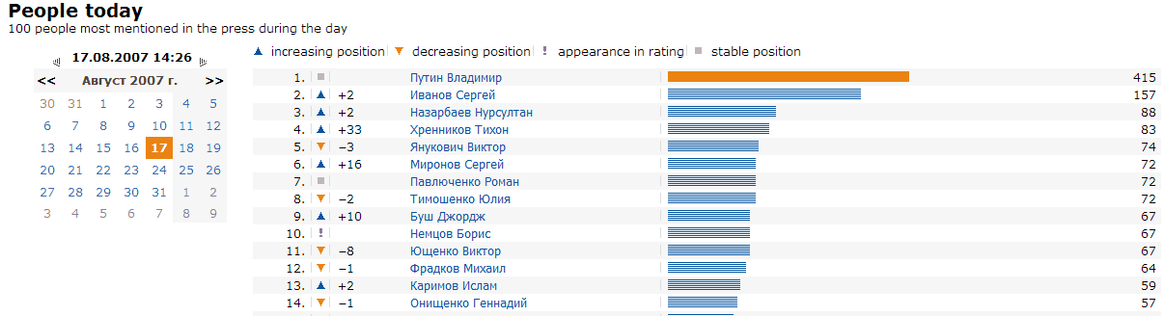
Top 100 persons in CIS mass media
Click on any date to get
the graph
in retrospective
Note the change of
position compared with
the previous day
People marked by “!”
were not in
Top 100 the day before
Click on the name to get
all relevant articles from
today’s mass media

Slide 29
Special services for researchers
Click here
Click here

Slide 30
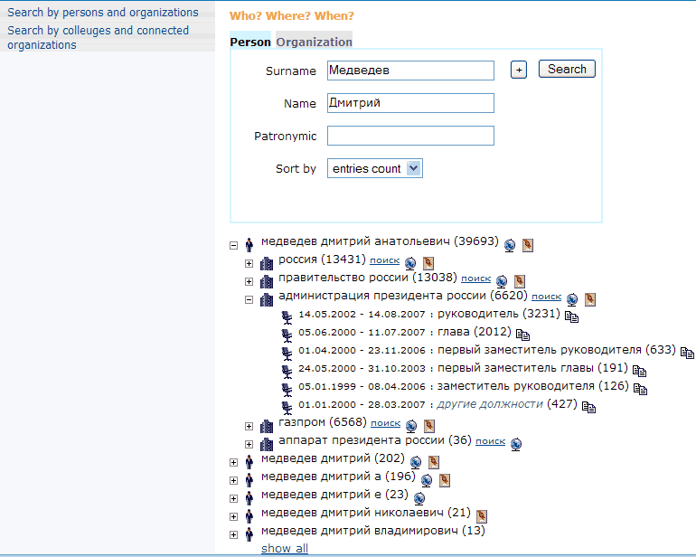
Automatic compilation of CV of any VIP based on mass media reports
Click to get more
options
Enter the name
of the person
Click to open
affiliation list
Click to open
position’s list
Click to get more details

Slide 31
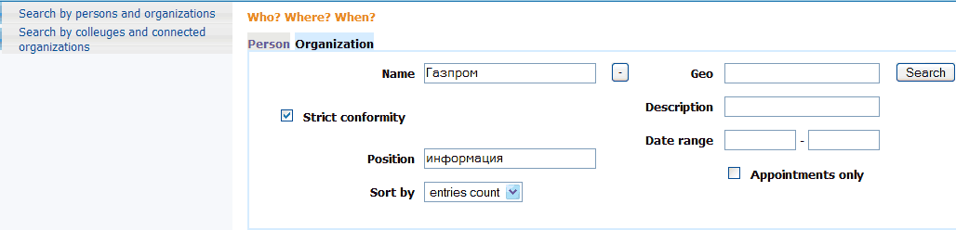
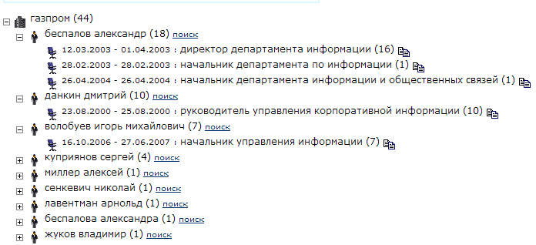
Find people affiliated with an organization
Click here
Enter the name of
organization and the word(s)
relevant to position
of a person
If necessary enter more details, e.g.
Geographical affiliation

Slide 32
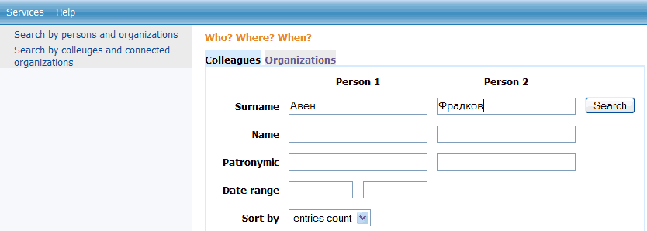
Find if two people ever worked together and what were their positions
Enter names of the people
Click here

Slide 33
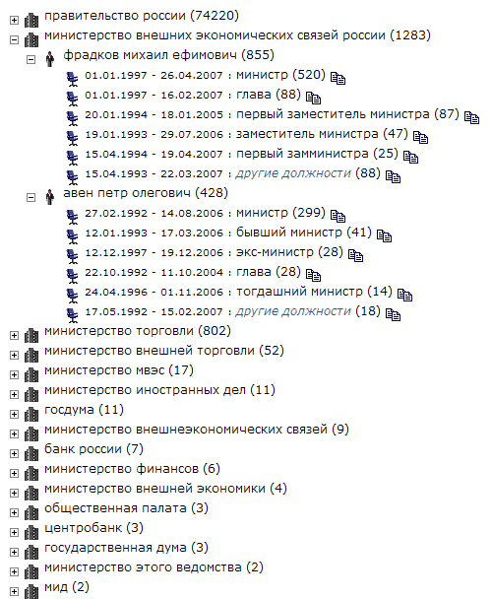
Browse the results of the search in mass media
Compare the results

Slide 34
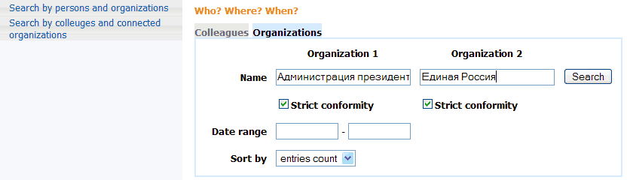
Find people affiliated with two organizations of your interest
Click here
Enter the names
of organizations

Slide 35
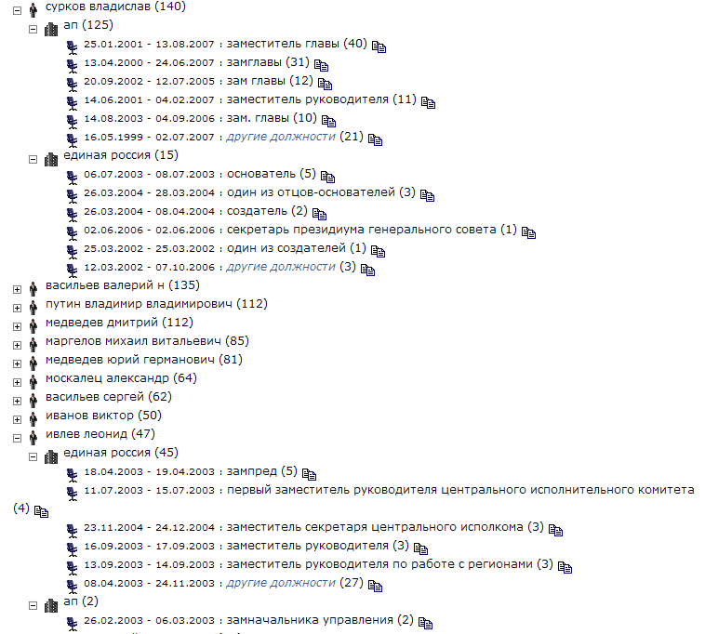
Browse the results

Slide 36
Statistical analysis of mass media.
Relative statistics or statistics based on a group of queries
This service can be used to determine a number if hits for two related objects or events mentioned together. The graph will reflect, in percent, the relation of the number of documents relevant to the first query to the number of documents relevant to the second query. You can create a group of queries (Query group – add) describing the information that you want to compare (a group of politicians, competing companies, etc). For each query you have to create a name, the actual text of the query, and its color. All groups of queries created by the user are saved and can be available in future sessions. You will see a graph that shows each line reflecting a number of documents relevant to its query.
Click here

Slide 37
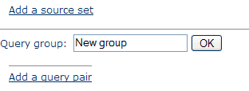
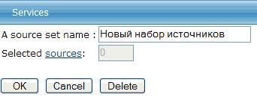
Build-up your Search area
Click here to create your Search area, i.e. a
set of databases which you are to use
for statistical research
Click here

Slide 38
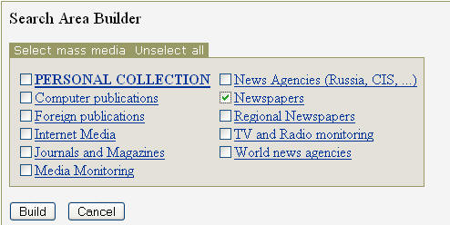
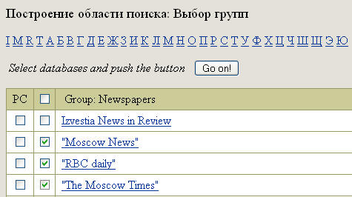
Build-up your Search area (continued)
Click
if you want to include the
whole group of databases into your set and
click Build.
Click
on the name of the group if only some databases
from this group should be included
into your set.
You can create your
PERSONAL COLLECTION
from databases contained
in different groups
Unselect the box ALL DATABASES
and select
the databases you want to include
into your set and click Go on!

Slide 39
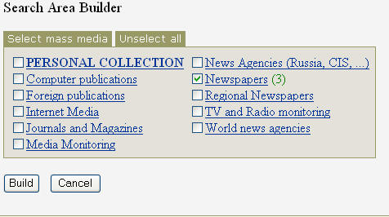
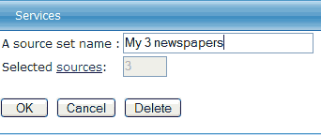
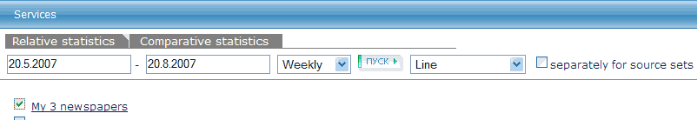
Build-up your Search area (continued)
Now all 3 newspapers are selected
Give a name to your new set
of databases and click OK
Your new Search area is created
and, if necessary, you can create
more Search areas

Slide 40

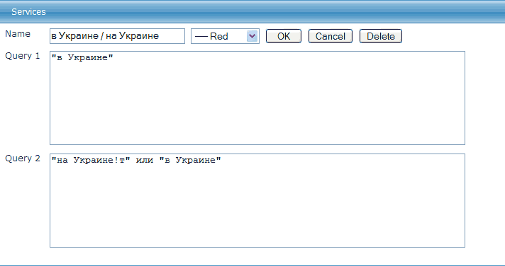
Create a pair of queries.
The number of documents containing Query 1 will be divided by number of documents containing Query 2.
Let’s check how often different mass-media use prepositions «в» and «на» with the word «Украина»
Click to create
a pair of queries
Choose color of the graph
Name your graph
Enter your queries
and click OK

Slide 41
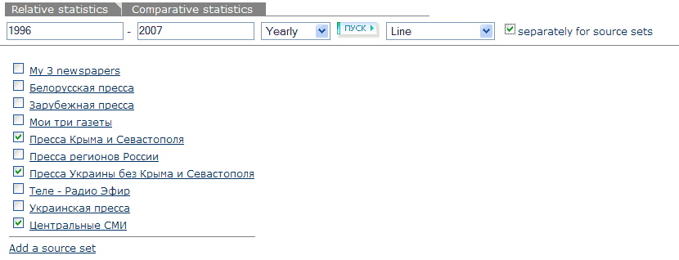
Choose the time span of the
documents you are
interested in
Choose time breakdown
Click
if separate graphs for each of your
Search areas, i.e. sets of databases,
are required
If required create new
Search areas
Check
the Search areas you want
to use in the current research
and click Go

Slide 42
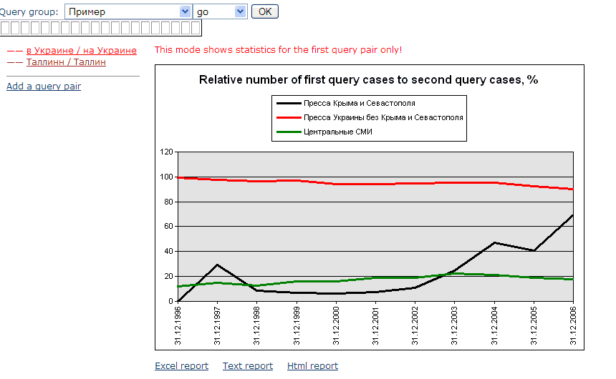
Get the graph.
Depending on the time span and the number of chosen Search areas the building up the graph may require several minutes
If required add a new
query pair and continue
the research
Get different types
of reports

Slide 43
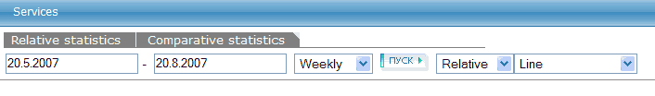
Statistical research.
Comparative statistics
This service allows you to compare the number of hits for particular subjects. You can create a group of queries (Query group – add) describing the information that you want to compare (a group of politicians, competing companies, etc). For each query you have to create a name, the actual text of the query, and its color. All groups of queries created by the user are saved and can be available in future sessions. You will see a graph that shows each line reflecting a number of documents relevant to its query. The graph can reflect results either in relative numbers (as a percent of the total number of documents in the selected databases for this period of time) or absolute numbers (as an actual number of documents relevant to the query).
Click

Slide 44

Follow the same procedure as in Relative statistics (see above) to create
Search areas and Query groups

Slide 45


Which of two countries, Italy or France, has been mentioned more often in Russian mass-media?
Create two queries

Slide 46

Choose the time span of the
documents you are
interested in
Choose between results in per cents
and in absolute figures
Choose time breakdown
Choose the way the graph
should be shown
Check
the Search areas
you want to
use in the current research
and click Go

Slide 47

Get the graph.
Depending on the time span and the number of chosen Search areas the building up the graph may require several minutes
If required add a new
query pair and continue
the research
If required add a new
query pair and continue
the research

Slide 48
Integrum’s dictionary of high-frequency words
Click here

Slide 49

The most comprehensive dictionary of high-frequency words.
The service is based on Integrum’s mass-media databases consisting of about 40 million documents and around 8 billion of words
10 000 words are divided in hundreds

Slide 50

Choose the type of the language

Slide 51

Sorting by frequency, alphabet, parts of speech

Slide 52



The First 100:
The most frequent nouns, verbs and adjectives

Slide 53

Dictionary shows all forms of any word

Slide 54

Usage examples from current mass-media

Slide 55
Recently a book has been published showing how Integrum can be used in scientific research
«Integrum: точные методы и гуманитарные науки»
Edited and compiled by Professor G. Nikiporets-Takigawa
Tokyo University of Foreign Studies
Foreword by Professor Viach. Vs. Ivanov
Director of the Institute of World Culture at Moscow State University
Professor of University of California
Member of Russian, American and British Academies of Sciences

Slide 56

The book can be ordered from:
levnermv@yandex.ru (attn: Dr Michael Levner)
www.mippbooks.com
www.esterum.com_x000b_

